Slide 1
Multilevel Linear Models
Prof. Andy Field

Slide 2
Aims
Multilevel models
Hierarchical data
Intraclass correlation
Benefits
Fixed and random coefficients
Comparing models
Covariance structures
Centring
Conducting and Interpreting an example analysis
Growth models
Types of growth model
Conducting and interpreting an example analysis

Slide 3
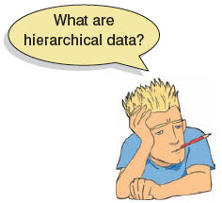
Hierarchical Data
Data structures are often hierarchical
Examples:
Children nested within classrooms
Data points nested within people
Employees nested within organizations
Patients nested within hospitals
Patients nested within doctors nested within clinics

Slide 4
A Two-Level Hierarchy
Level
2
Class 1
Class 2
Class 3
Class 4
Class 5
Class 6
...
Class n
Child 1
Child 9
Child 13
Child 20
Child 28
Child 33
Child a
Child 2
Child 10
Child 14
Child 21
Child 29
Child 34
Child b
Child 3
Child 11
Child 15
Child 22
Child 30
Child 35
Child c
1
Child 4
Child 12
Child 16
Child 23
Child 31
Child 36
Child d
Child 5
Child 17
Child 24
Child 32
Child 37
Child e
Child 6
Child 18
Child 25
Child 38
Child 7
Child 19
Child 26
Child 8
Child 27

Slide 5
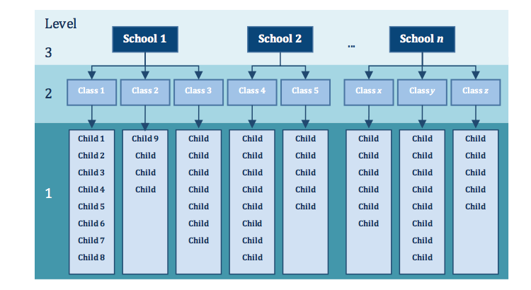
A Three-Level Hierarchy

Slide 6
Intraclass Correlation (ICC)
Data from the same context will be more similar than data from different contexts
E.g. children in the same class will perform more similarly than children from different classes
Lack of independence
Creates problems in ANOVA/regression (correlated residuals)
The ICC measures the variability within contexts
E.g. the variability within classrooms

Slide 7
Benefits of Multilevel Models
Homogeneity of regression slopes
Model the variability in regression slopes
Assumption of independence
You can model the relationships between cases
(Regression for repeated observations)
Missing data
MLMs can cope with missing data

Slide 8
An Example: Cosmetic Surgery
Post_QoL
This is a measure of quality of life after the cosmetic surgery.
Base_QoL
Quality of life before the surgery.
Surgery
A dummy variable that specifies whether the person has undergone cosmetic surgery (1) or whether they are on the waiting list (0).
Clinic
Which of 10 clinics the person attended to have their surgery.
Age
The person’s age in years.
BDI
Natural levels of depression measured using the Beck Depression Inventory (BDI).
Reason
This dummy variable specifies whether the person had/is waiting to have surgery purely to change their appearance (0), or because of a physical reason (1).
Gender
Whether the person was a man (1) or a woman (0).

Slide 9
Fixed vs. Random Coefficients
Intercepts and slopes can be fixed or random
In OLS regression they are fixed
Fixed coefficients
Intercepts/slopes are assumed to be the same across different contexts
Random coefficients
Intercepts/slopes are allowed to vary across different contexts

Slide 10
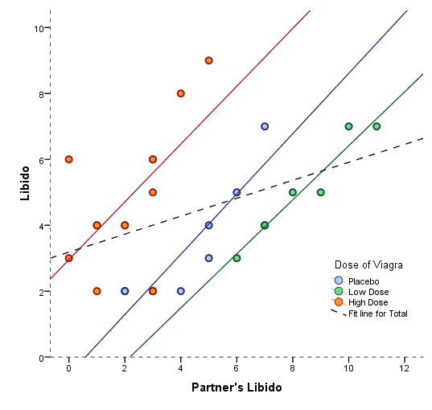
Fixed Slope, Random Intercept

Slide 11
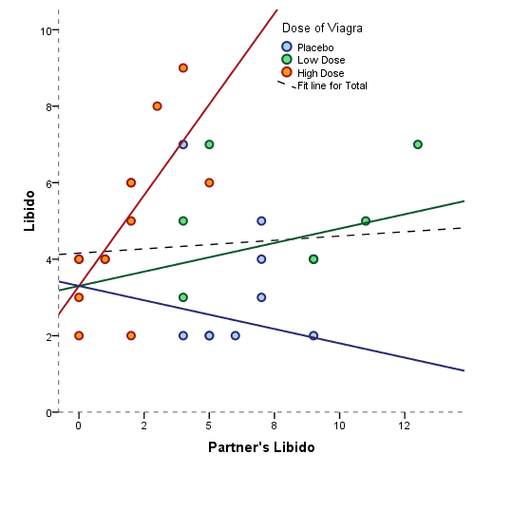
Random Slope, Fixed Intercept

Slide 12
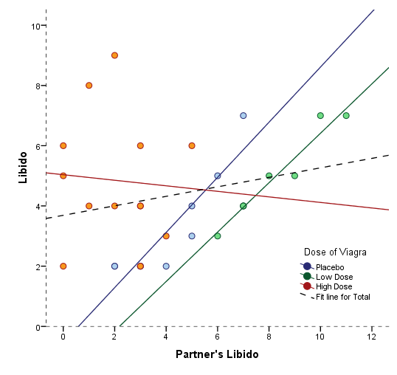
Random Slope, Random Intercept

Slide 13
How to Represent These Models
Fixed intercepts and slopes
Random intercepts and fixed slopes
Fixed intercepts and random slopes
Random intercepts and random slopes

Slide 14
The Surgery Example
Fixed intercepts and slopes
Random intercepts and random slopes

Slide 15
Comparing Models
Models should be built up gradually
Start with fixed coefficients
Change one aspect of the model and compare to the previous with the change in the –2LL
Assessing fit
AIC
BIC

Slide 16
Covariance Structures
Variance components
Random effects are independent with similar variances
Diagonal
Random effects are independent with different variances
AR(1)
Random effects are related with data points closer in time being more similar than those distant in time
Variances of random effects are similar
Unstructured
Covariances and variances of random effects are unpredictable

Slide 17
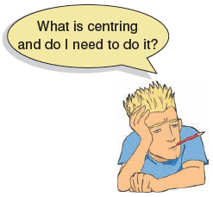
Centring
Grand mean centring
Take each score and subtract from it the mean of all scores (for that variable)
Group mean centring
Take each score and subtract from it the mean of scores from the same group (for that variable)
Effects of centring in multilevel models
The effects are complicated
Models using centred variables tend to be more stable
It can help with problems of multicollinearity

Slide 18
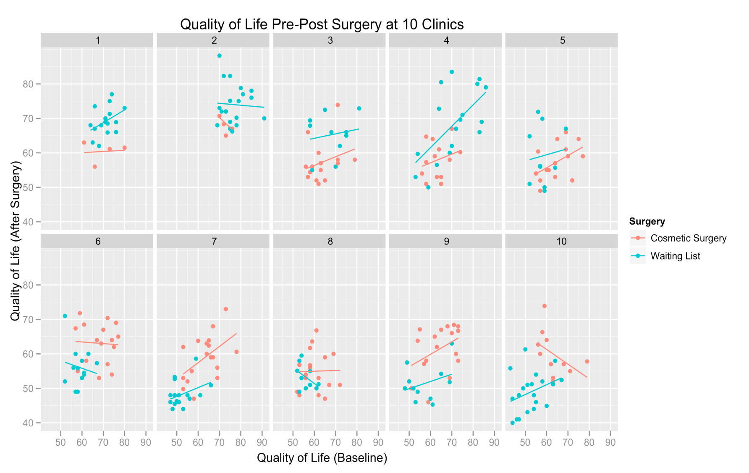
Picturing the Data

Slide 19
Ascertaining Whether There Is Variation over Your Contexts
First we need to fit a baseline model in which we include only the intercept:
interceptOnly <-gls(Post_QoL ~ 1, data = surgeryData, method = "ML")
summary(interceptOnly)
Next, we fit a model that allows intercepts to vary over contexts:
randomInterceptOnly <-lme(Post_QoL ~ 1, data = surgeryData, random = ~1|Clinic, method = "ML")
summary(randomInterceptOnly)
Finally, we compare these two models to see whether the fit has improved as a result of allowing intercepts to vary. If it has, we jump on the runaway train to multilevel insanity; if it has not, we do a little dance of joy into the loving arms of a simpler life:
anova(interceptOnly, randomInterceptOnly)

Slide 20
Output of Model Comparison

Slide 21
Add the variable Surgery as a predictor
To add the variable Surgery as a predictor, execute:
randomInterceptSurgery <-lme(Post_QoL ~ Surgery, data = surgeryData, random = ~1|Clinic, method = "ML")
summary(randomInterceptSurgery)

Slide 22
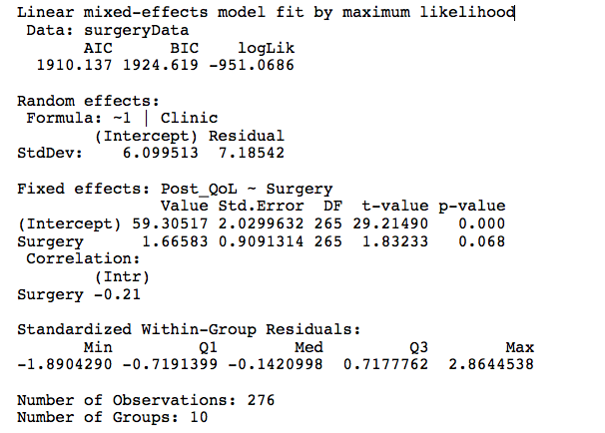

Slide 23
Add Next Predictor to the Model
Add quality of life after surgery, with intercepts varying across clinics:
randomInterceptSurgeryQoL <-lme(Post_QoL ~ Surgery + Base_QoL, data = surgeryData, random = ~1|Clinic, method = "ML")
summary(randomInterceptSurgeryQoL)

Slide 24
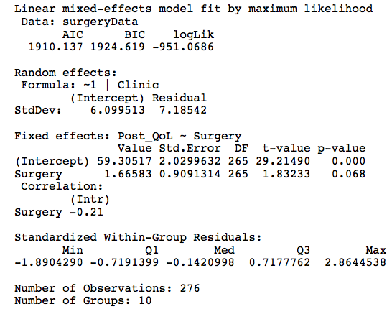
Summary of the Final Model

Slide 25
Compare Models
We can have a look at how the fit of the models has improved using the anova() function that we used before; the following will compare all three models that we have so far fitted):
anova(randomInterceptOnly, randomInterceptSurgery, randomInterceptSurgeryQoL)

Slide 26
Compare Models

Slide 27
Introducing Random Slopes
addRandomSlope<-lme(Post_QoL ~ Surgery + Base_QoL, data = surgeryData, random = ~Surgery|Clinic, method = "ML")
summary(addRandomSlope)
anova(randomInterceptSurgeryQoL, addRandomSlope)

Slide 28
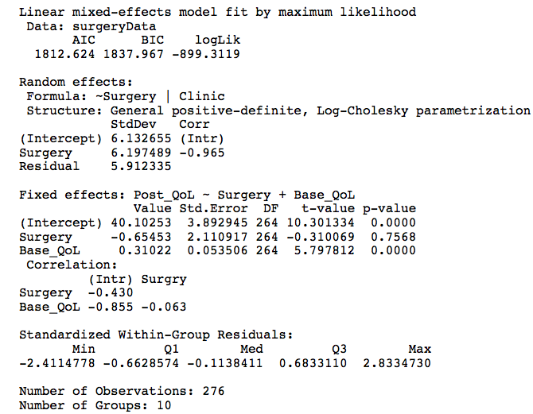
Summary of the Model Containing Both Random Slopes and Intercepts

Slide 29
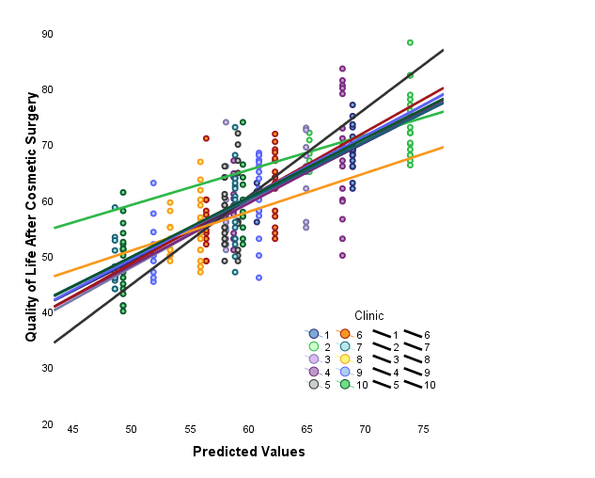
The Model

Slide 30
Adding an Interaction Term to the Model
addReason<-lme(Post_QoL ~ Surgery + Base_QoL + Reason, data = surgeryData, random = ~Surgery|Clinic, method = "ML")
finalModel<-lme(Post_QoL ~ Surgery + Base_QoL + Reason + Surgery:Reason, data = surgeryData, random = ~Surgery|Clinic, method = "ML")
We need to see whether adding these new terms has improved the fit of the model, and again we can simply use the anova() function:
anova(addRandomSlope, addReason, finalModel)

Slide 31
Output

Slide 32
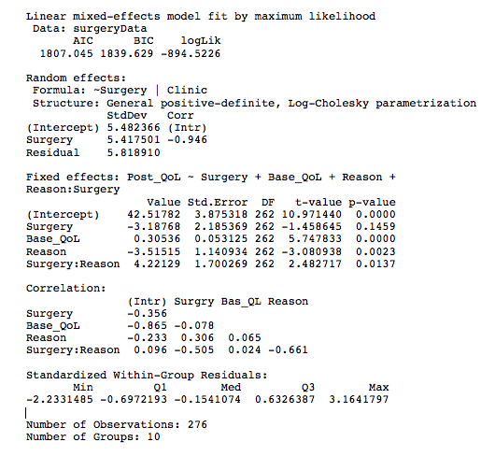
Final Model Summary

Slide 33
Follow-Up Analysis
Surgery to change appearance:
cosmeticSubset<-surgeryData$Reason==0
cosmeticModel<-lme(Post_QoL ~ Surgery + Base_QoL, data = surgeryData, random = ~Surgery|Clinic, subset= cosmeticSubset, method = "ML”)
summary(cosmeticModel)
Surgery for a physical problem:
physicalSubset<- surgeryData$Reason==1
physicalModel<-lme(Post_QoL ~ Surgery + Base_QoL, data = surgeryData, random = ~Surgery|Clinic, subset= physicalSubset, method = "ML")
summary(physicalModel)

Slide 34
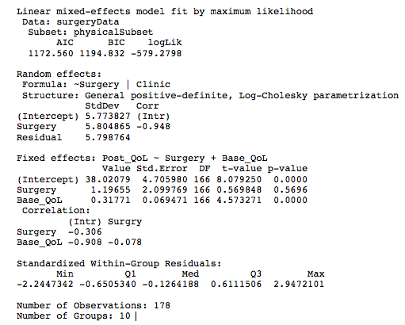
The Model for Those Who Had Surgery for a Physical Reason

Slide 35
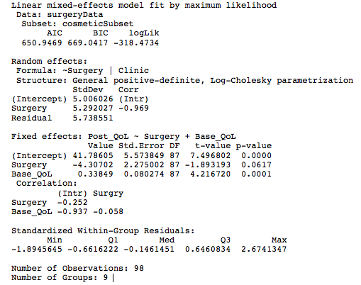
The Model for Those Who Had Cosmetic Surgery

Slide 36
Growth Models
Growth models look at the rate of change of a variable over time
Depression over 8 weeks of treatment
Back pain over 10 weeks of physiotherapy
Profits over months of the year
Radioactive decay

Slide 37
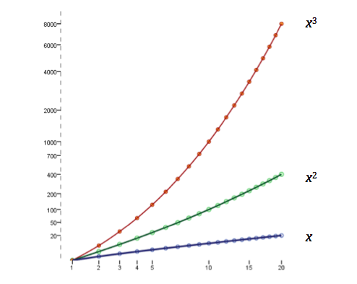
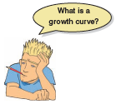
Types of Growth Curve

Slide 38
An Example: The `Honeymoon Period’
Speed dating event
After a speed dating event data were collected on all people who ended up in a relationship with the person that they met on the speed dating night.
None of the people measured were in the same relationship.
Satisfaction_Baseline
A 10-point scale (0 = completely dissatisfied, 10 = completely satisfied)
Satisfaction_6_Months
Life satisfaction at 6 months (0–10)
Satisfaction_12_Months
Life satisfaction at 12 months (0–10)
Satisfaction_18_Months
Life satisfaction at 18 months (0–10)
Gender

Slide 39
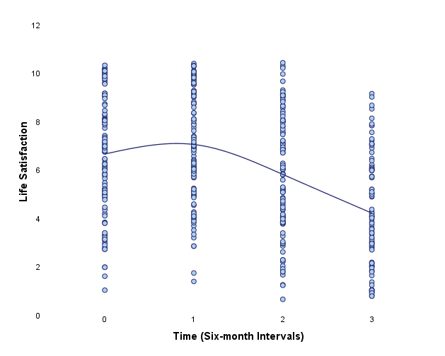
The Data

Slide 40
Restructuring Data
Data entry for multilevel models …
Need the variable Time to be represented by a single column. We refer to this format as the ‘long’ format. As such we need to restructure the data.
But, in repeated measures designs we’re used to entering data so that instances of the outcome appear in different columns.

Slide 41
Setting up the Basic Model
First, we fit a baseline model in which we include only the intercept:
intercept <-gls(Life_Satisfaction ~ 1, data = restructuredData, method = "ML", na.action = na.exclude)
Next, we need to fit the same model, but this time allowing the intercepts to vary across contexts (in this case we want them to vary across people):
randomIntercept <-lme(Life_Satisfaction ~ 1, data = restructuredData, random = ~1|Person, method = "ML", na.action = na.exclude, control = list(opt="optim"))

Slide 42
Adding in Time as a Fixed Effect
We can quickly update the previous model (randomIntercept) to include Time as a predictor by executing:
timeRI<-update(randomIntercept, .~. + Time)

Slide 43
Introducing Random Slopes
We use the update() function to create a new model (called timeRS) which is identical to the previous model (timeRI) but updates the random part of the model to be random = ~Time|Person:
timeRS<-update(timeRI, random = ~Time|Person)

Slide 44
Modelling the Covariance Structure
We can add a covariance structure to the model using the update() function to create a new model (called ARModel) which is identical to the previous model (timeRS) but adds in a first-order autoregressive covariance structure:
ARModel<-update(timeRS, correlation = corAR1(0, form = ~Time|Person))

Slide 45
Comparing Models
We can compare all five models by executing:
anova(intercept, randomIntercept, timeRI, timeRS, ARModel)

Slide 46
Final Model
We can take a quick look at the final model, and the confidence intervals for the parameter estimates within it by using:
summary(ARModel); intervals(ARModel)

Slide 47
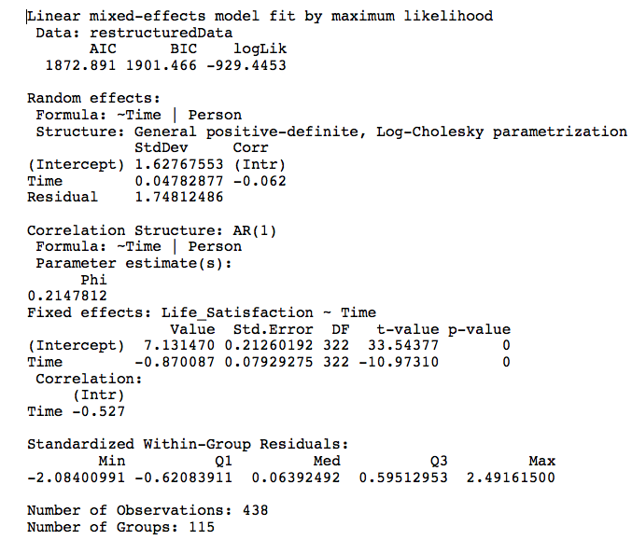

Slide 48
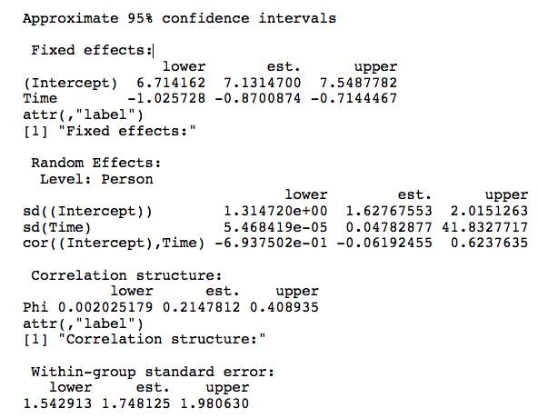
Parameter Estimates

Slide 49
To Sum Up …
Data can be hierarchical and this hierarchical structure can be important.
Most of the tests that you learn simply ignore the hierarchy.
Hierarchical models are just a fancy regression in which you can estimate the variability in the slopes and intercepts within entities.
Slopes and intercepts can be random variables (allowed to vary) rather than fixed (assumed to be equal in different situations).
Start with a model that ignores the hierarchy and then add in random intercepts and slopes to see if they improve the fit of the model.
Growth curves model trends in the data over time
These trends can also have variable intercepts and slopes.

